Slide 1

Intelligent Marketing Text Generation
Multimodal text summarization applied in the fashion industry
Authors: Jingxuan Li, Tu Xue, Wenxuan Tang, Vivian Chan, Fenny Jin, Guanyuan Shuai

Slide 2
Table of contents
01
02
03
Introduction
Discovery
Technical
04
05
Solution Development
Summary
Business background
Prototype and data exploratory
Technical solution design
Modeling execution and evaluation
Achievements and future plan

Slide 3

01
Introduction

Slide 4
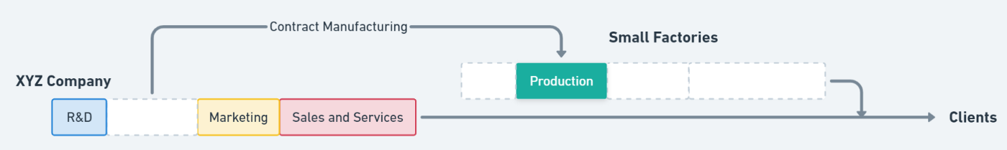
Business Background
Fashion Retailer

Slide 5
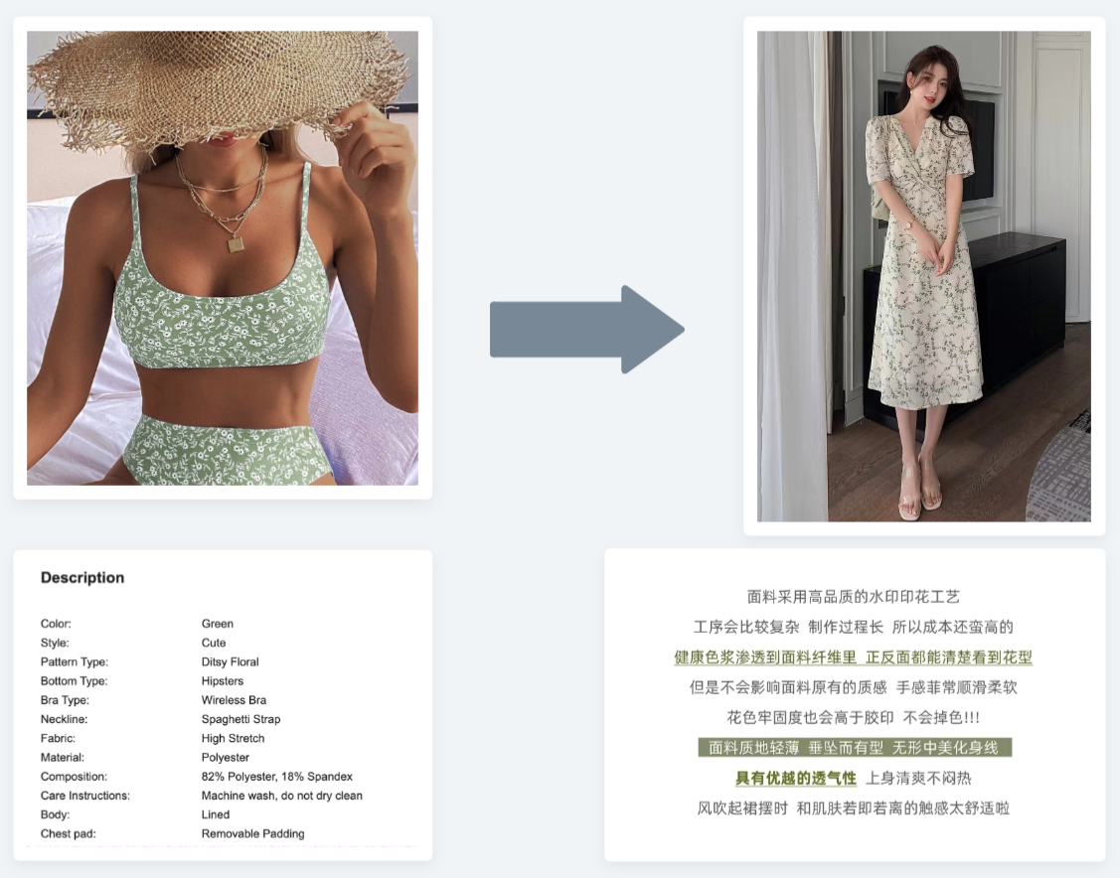
Project Background
Targets customers’ interest
Overwhelming burden for human labor

Slide 6

Discovery
02

Slide 7
Discovery Process
1
2
3
4
Naturalistic Observation
Participant Observation
Interview
Requirement
Summary
More detailed description and images for products.
More consumers buy clothes online
Writing descriptions for each product is labor-intensive
AI writer that generates great product description

Slide 8
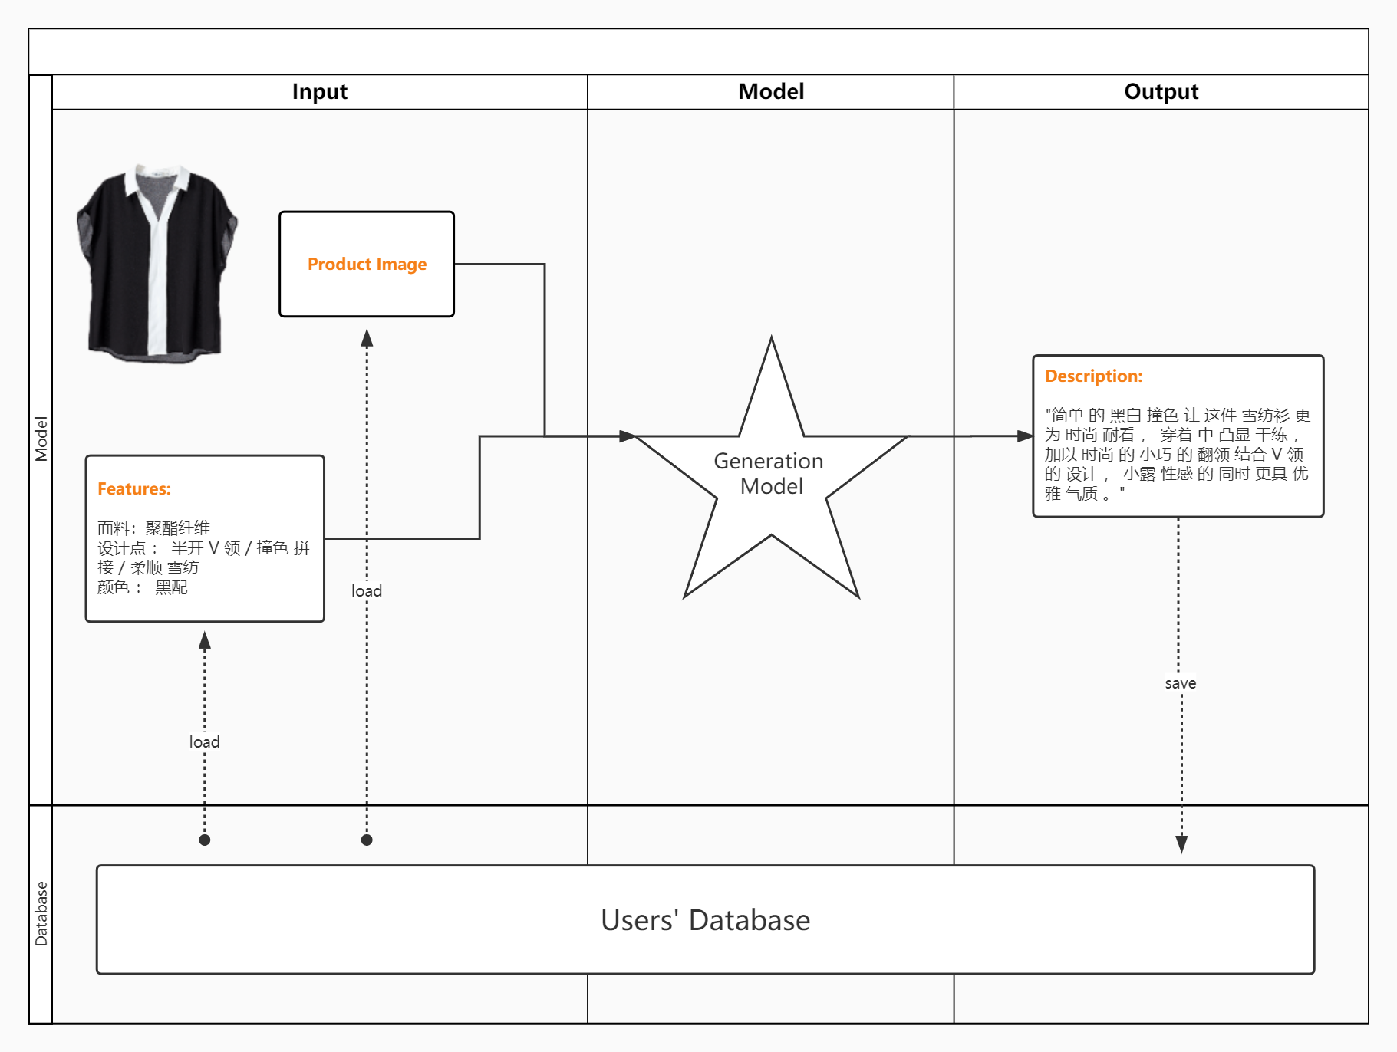
Prototype
User Input
Model Output
User inputs images and selling points.
Model generates compelling product descriptions based on texts and images input from users.

Slide 9
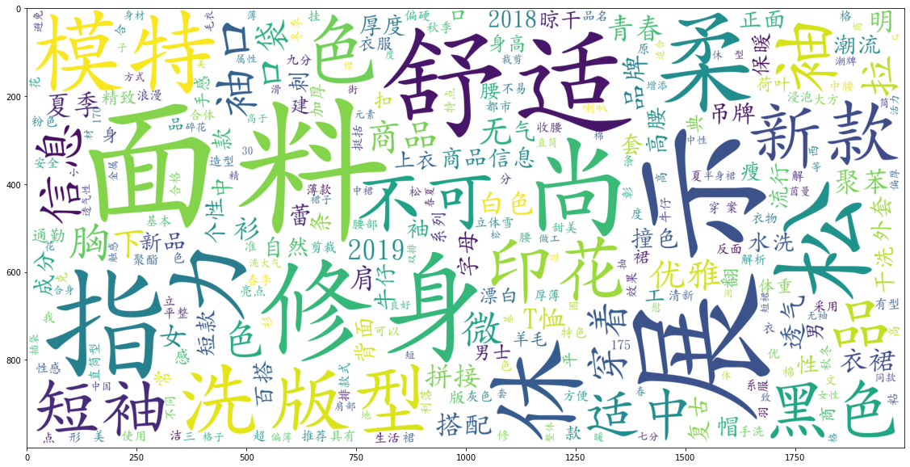
Exploratory Data Analysis
Texts Length
< 100
50%
100 ~200
33%
> 200
17%
Keywords from Texts

Slide 10

Technical
03
Technical solution design

Slide 11
Main Objectives
Design a summarizer that can automatically generate a textual summary for clothing products.
Propose a multimodal pointer-generator network in the product summarization task.
Adopt multiple aspect methods to improve importance, non-redundancy, and readability, respectively.

Slide 12
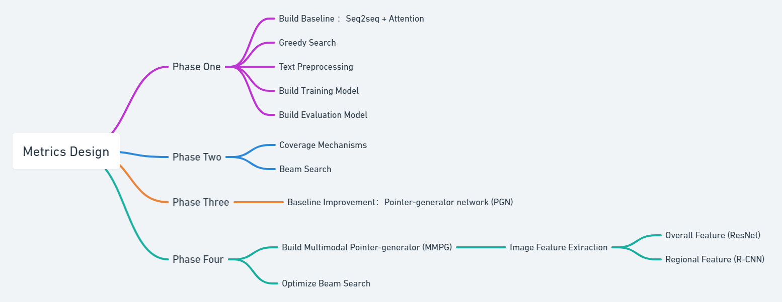
Metrics Design WorkFlow

Slide 13

Solution
Development
04

Slide 14
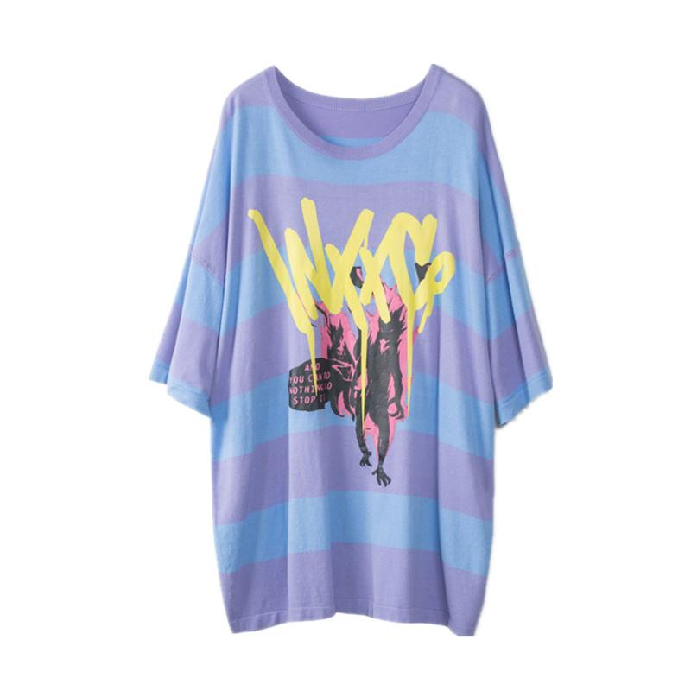
Data Processing
Key words
姜莉莎 系列 潮牌 短袖 针织衫 宽松 条纹 印花 新款 商场 同款 兰紫 条纹 色 ， 青春 流行 ， 宽松 型 ， 青春 休闲 ， 圆领 ， 合格 ， 品名 ： 针织衫 ， 颜色 ： 兰紫 条纹 色 ， 规格 ： S ( 165 / 84A ) ， 品牌 ： INXX ， 衣 长 ， 胸围 ， 中 长 ， 弹力 ， 适中 ， 长款 ， 短款 ， 修身 ， 稍厚 ， 宽松 ， 合体 ， 袖口 ， 超 宽松 ， 袖长 ， 厚款 ， 肩宽
Index
3JAQUzXttp
Image embeddings
Description
这款 潮感 十足 的 条纹 撞色 T恤 ， 色彩 亮丽 鲜艳 吸引 眼球 ， 穿 出潮 人范 ； 衣面 富有 个性 的 印花 装饰 ， 设计 感强 十分 适合 街头 穿着 搭配 ； 甄选 细腻 棉质 面料 制作 ， 穿着 细腻 顺滑 ， 舒适度 高 。
-0.8808510303497314, -0.515639066696167, -0.6087733507156372, -1.0540932416915894, -0.8381232023239136, -0.34195348620414734, -0.8589673638343811, 0.3963998854160309,
……
……
(1000 dimensions generated with ResNet101)

Slide 15
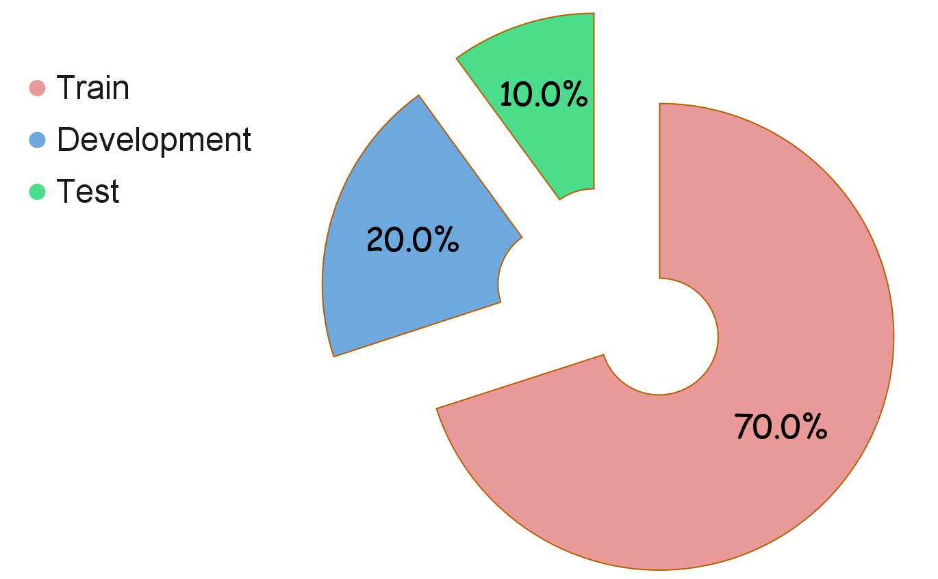
Data Processing
Total data : 30,000

Slide 16
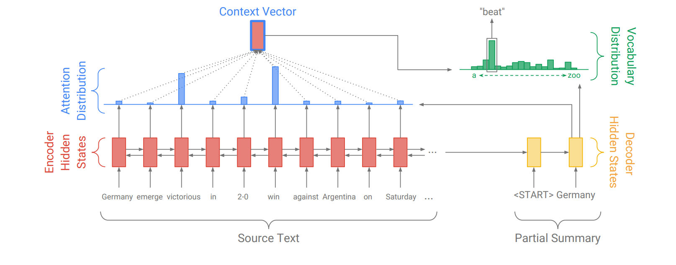
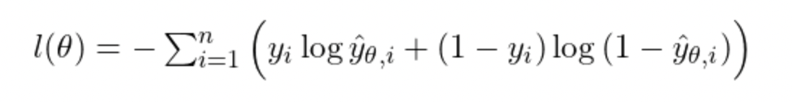
Baseline
Seq2Seq (Sequence to Sequence) + Attention
Negative Maximum Likelihood

Slide 17
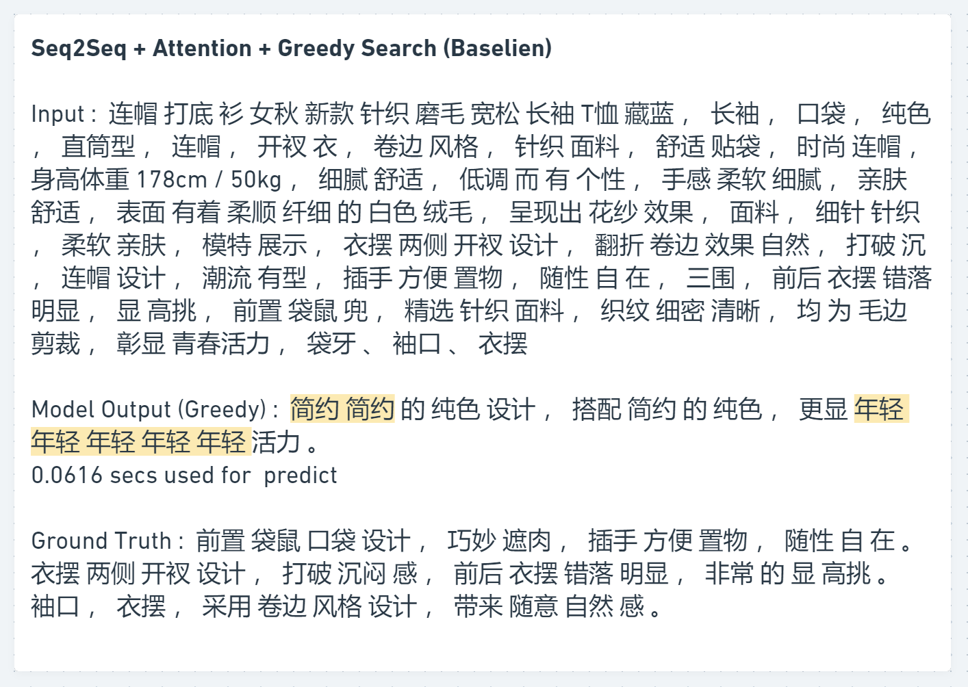
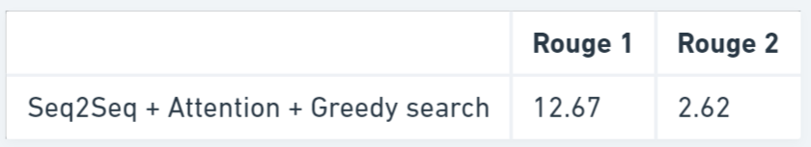
Baseline
Seq2Seq (Sequence to Sequence) + Attention
Analysis
Sentences are fluent
Repetitive words
Quick generation time

Slide 18
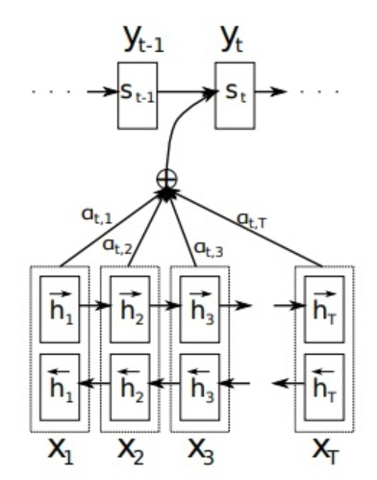
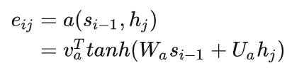
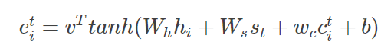
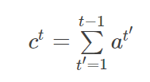
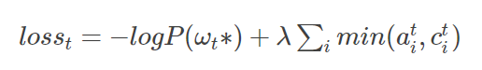
Version 2
Coverage + Beam Search
Original Attention
Decoder
Original Attention
With Coverage
Weight of the attention of the previously generated vocabulary
Encoder
New Loss function
Attention Mechanisme

Slide 19
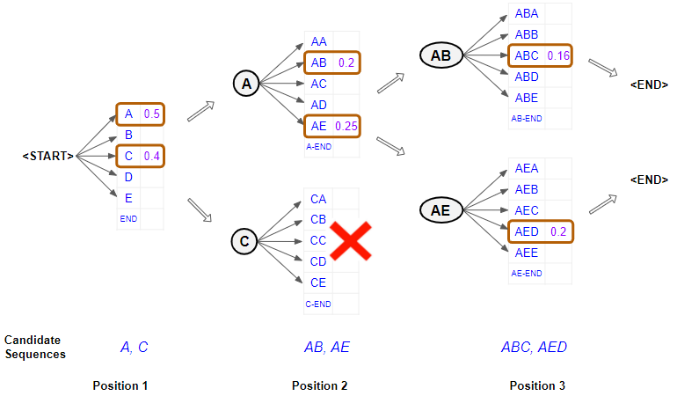
Version 2
Coverage + Beam Search

Slide 20
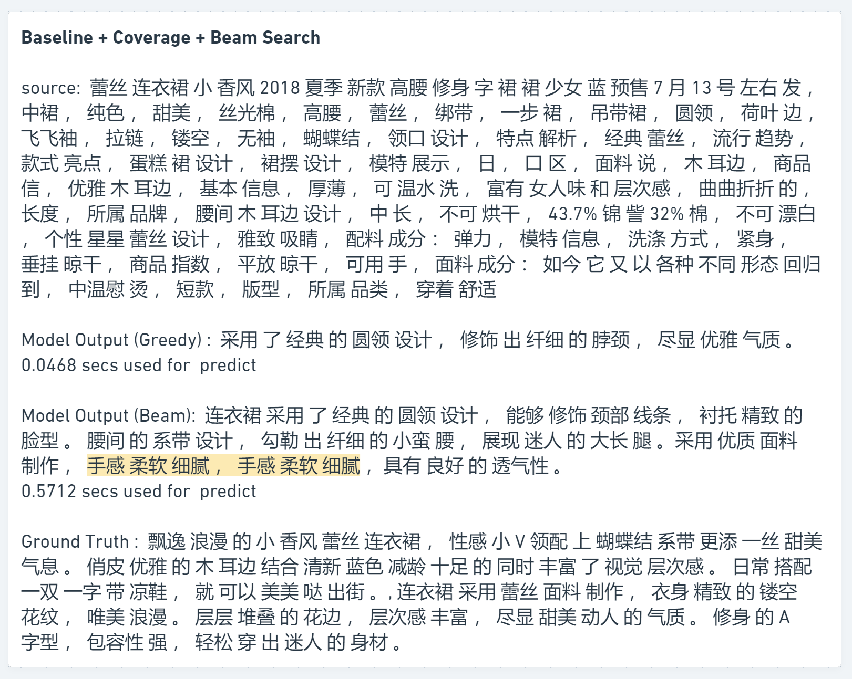
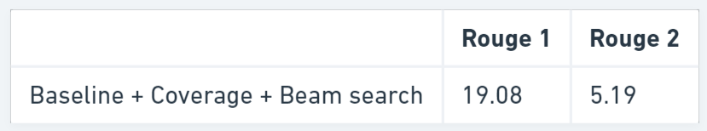
Version 2
Coverage + Beam Search
Analysis
Sentences are fluent
Less repetitive words, but repetitive phase
Quick generation time for Greedy Search
10x slower for Beam Search

Slide 21
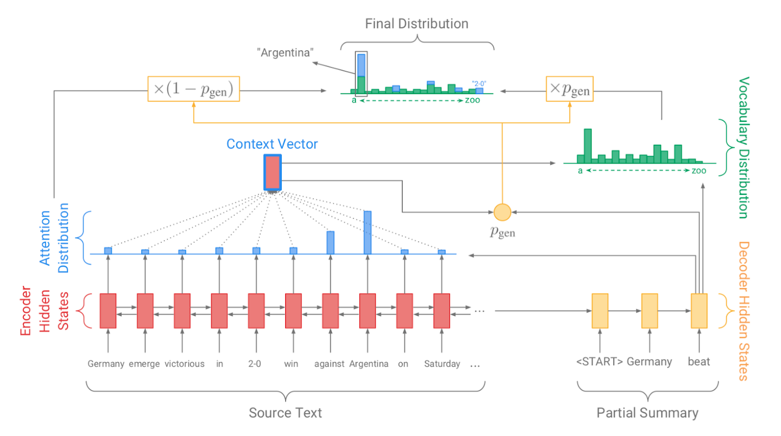
Version 3
PGN + Coverage + Beam Search

Slide 22
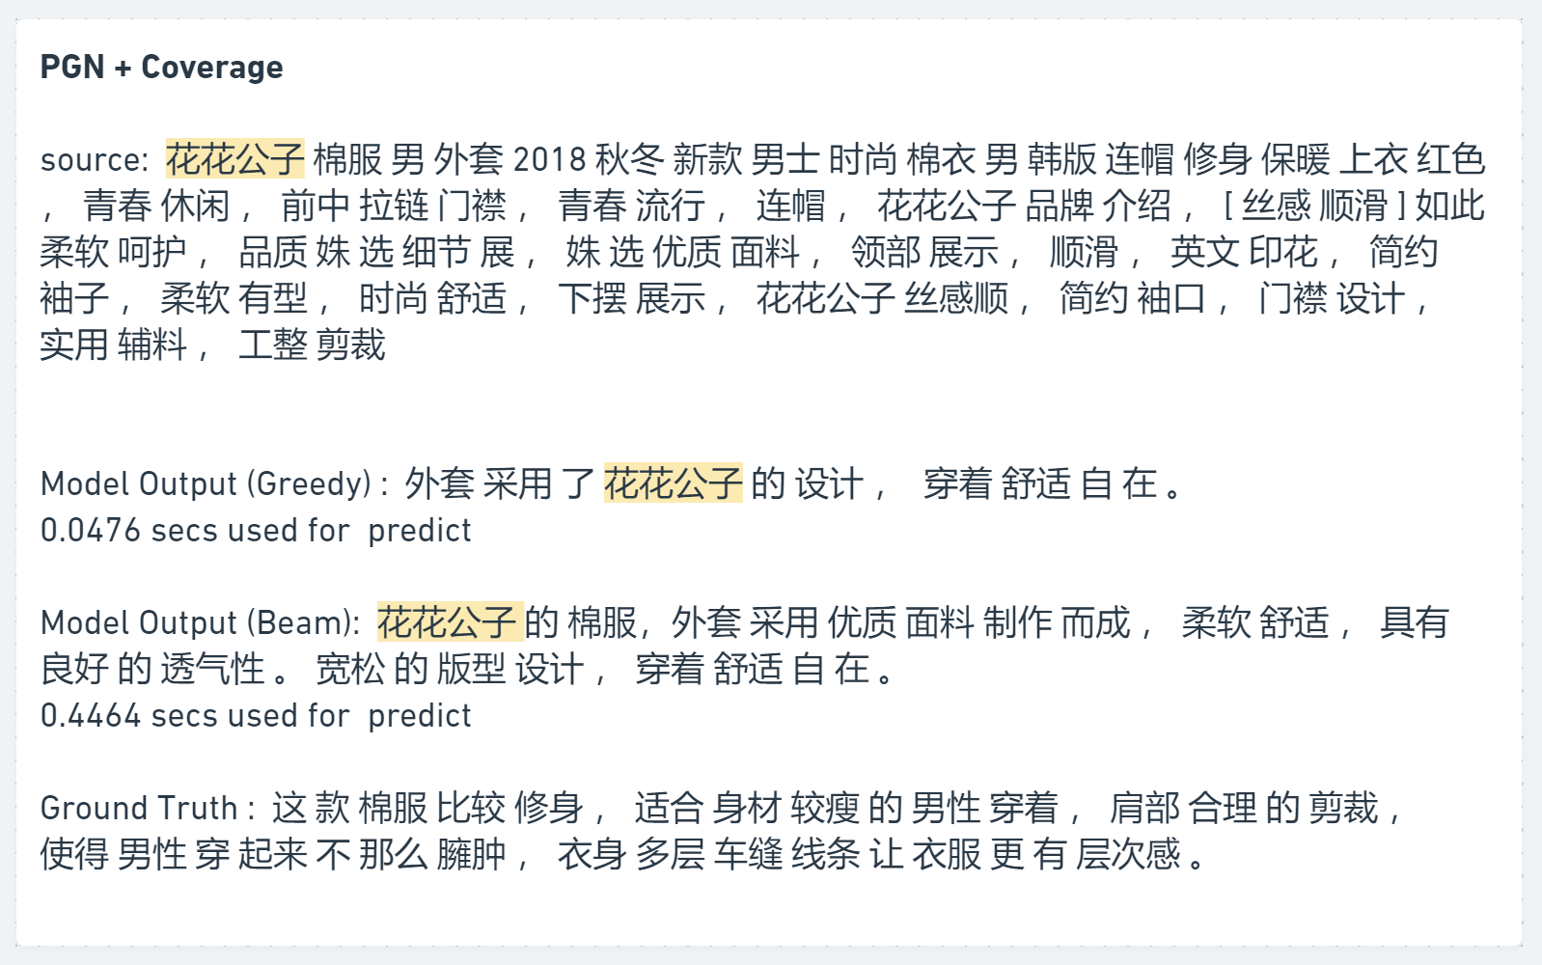
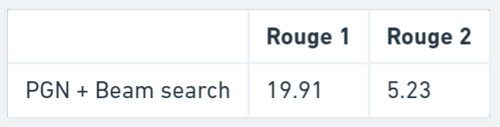
Version 3
PGN + Coverage + Beam Search
Analysis
Important words copied

Slide 23
Version 4
PGN + CV
Image embeddings
-0.8808510303497314, -0.515639066696167, -0.6087733507156372, -1.0540932416915894, -0.8381232023239136, -0.34195348620414734, -0.8589673638343811, 0.3963998854160309,
……
……
(1000 dimensions generated with ResNet101)

Slide 24
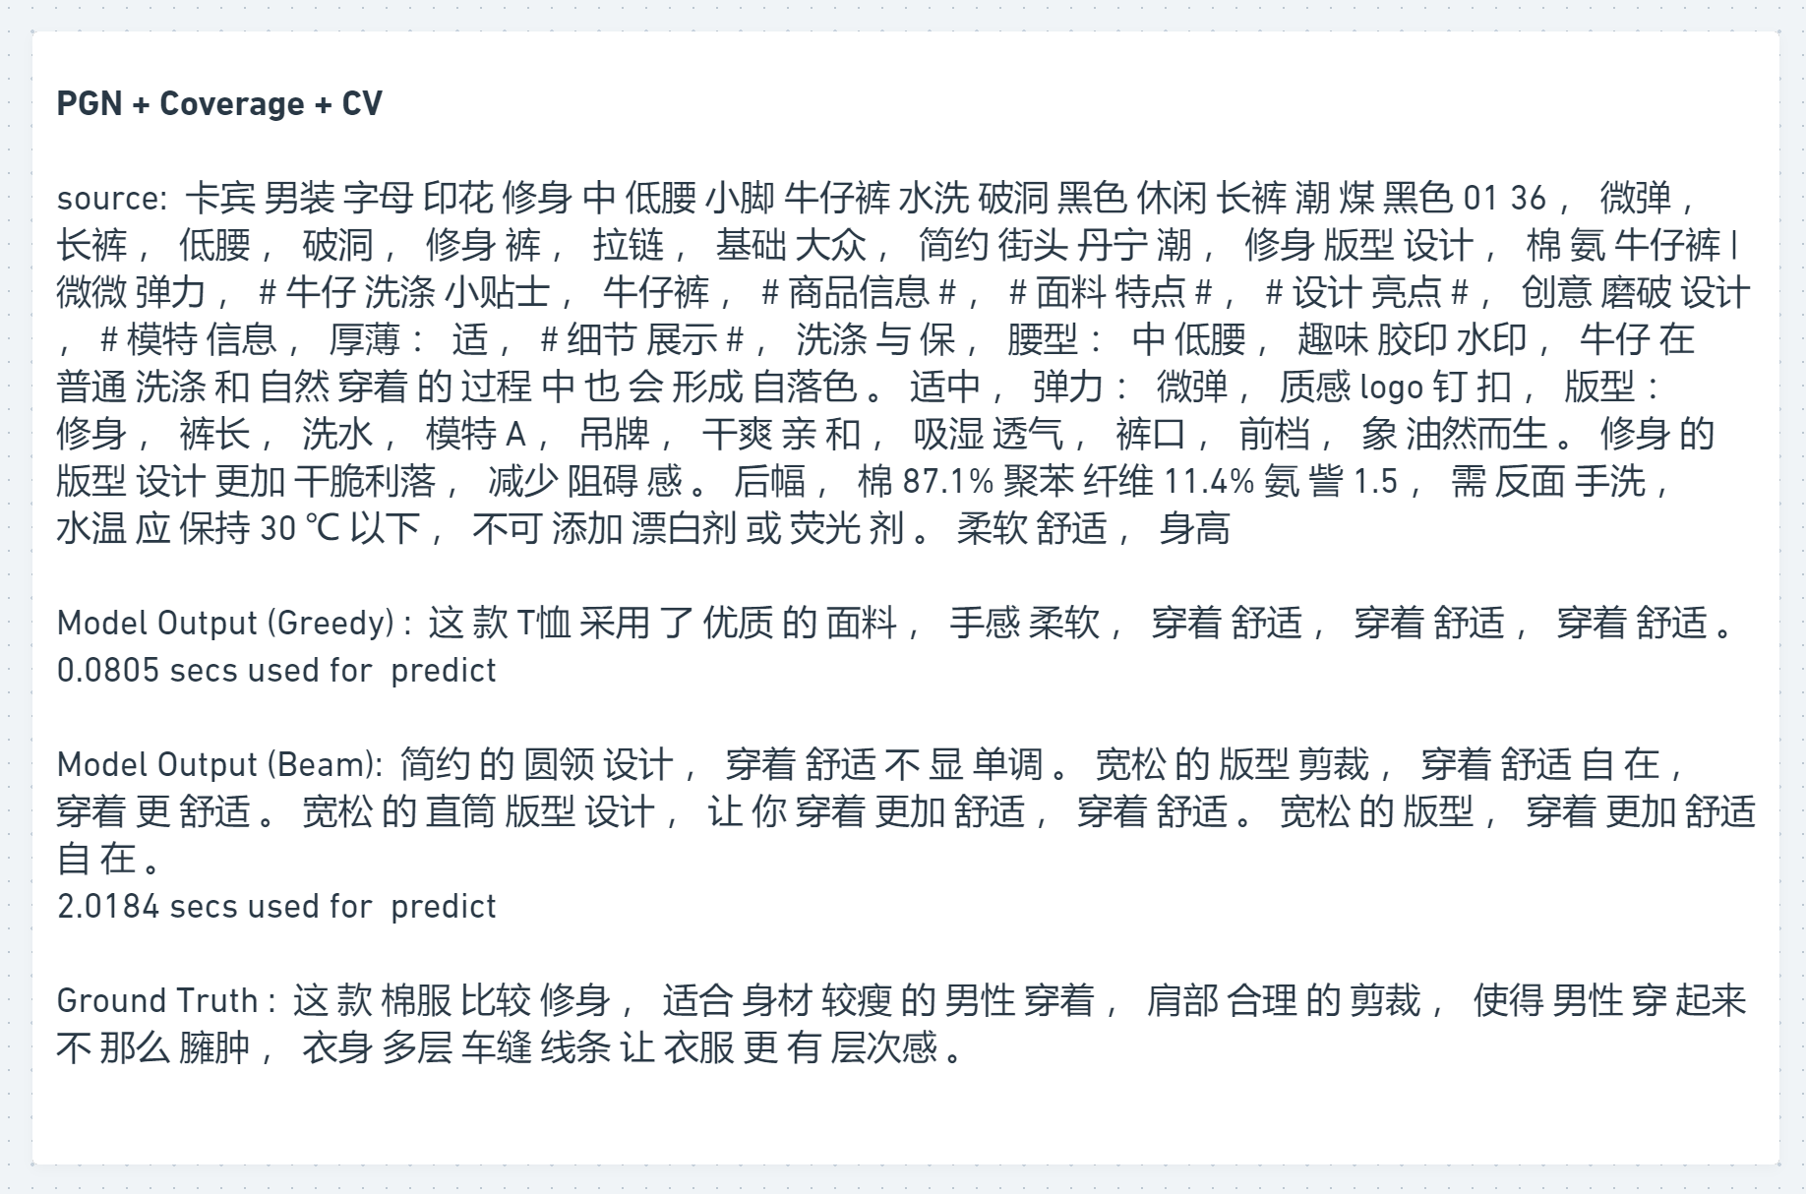
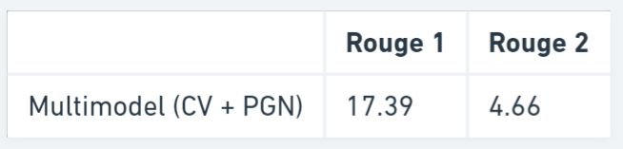
Version 4
PGN + CV
Analysis
Much more slower for generation
Loss of PGN copy capability
Reduced Coverage capacity

Slide 25

Summary
05

Slide 26
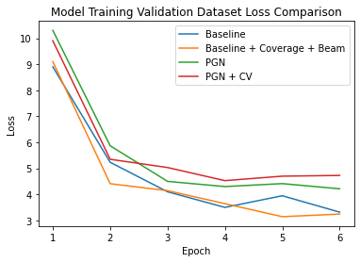
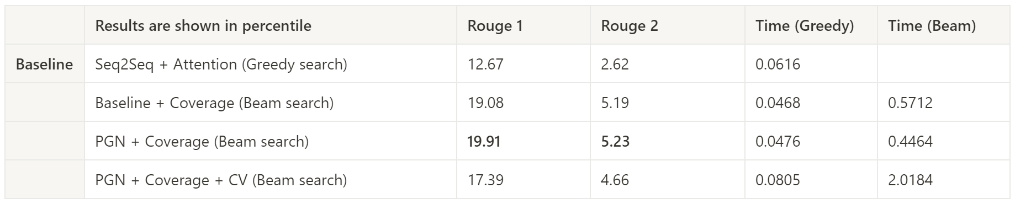
Solution Assessment

Slide 27


Business Implication
14 Languages

Slide 28

Assessment
Better engagement
Higher conversion rate

Slide 29
Next Step
Dataset Improvement
Expand dataset size Increase diversity
Model Improvement
Keywords input
Final Thoughts
Assess model complexity and ROI

Slide 30
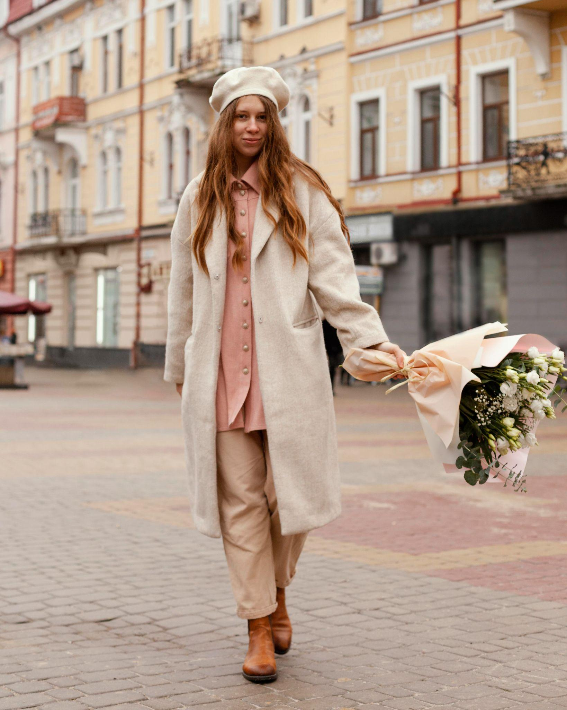
Thanks!
Do you have any questions?
https://medium.com/@jingxuanli/product-design-process-for-intelligent-marketing-text-generator-multimodal-text-summarization-d8139ee433dc

